Slide 1
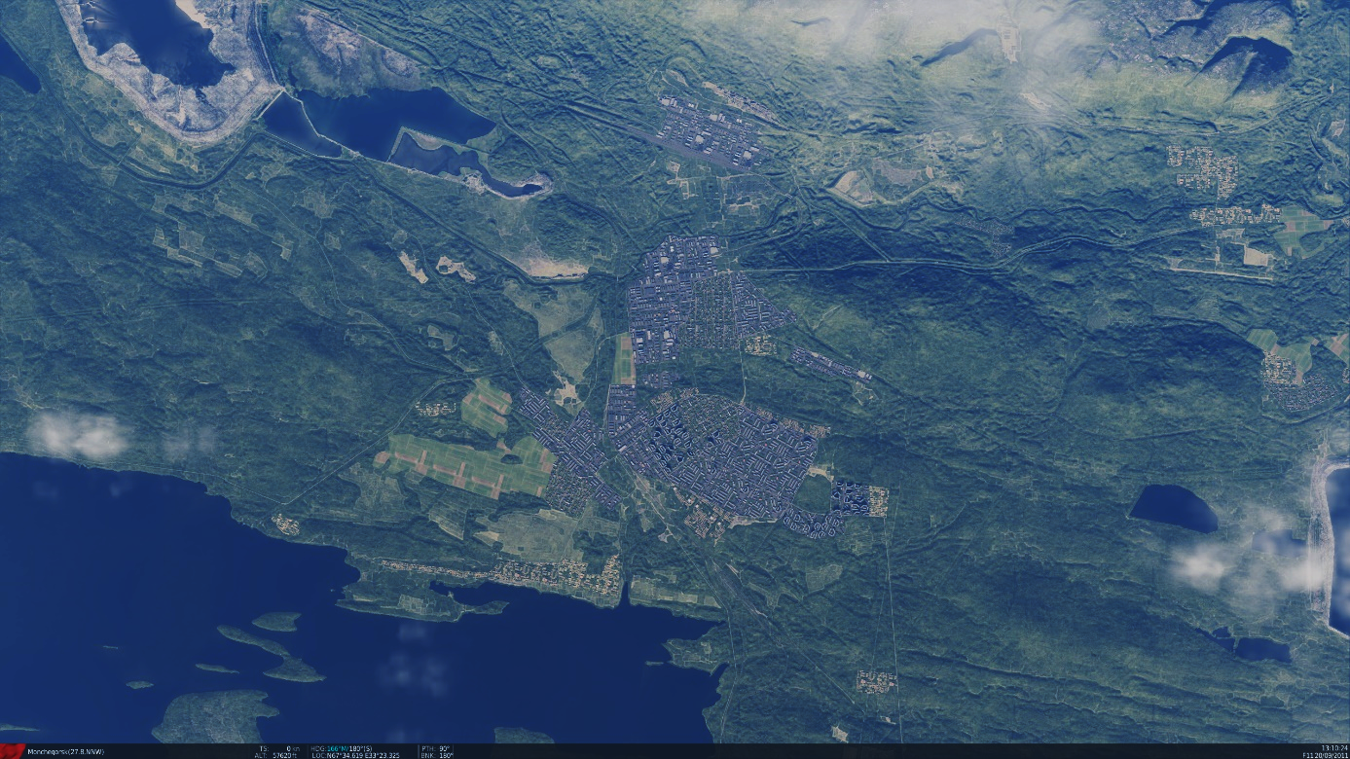
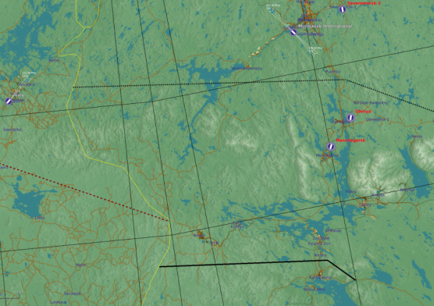


SRNTGT073 - Apatite Radar Factory
SRNTGT073
N
N67 34.851 E033 23.314 – 500 ft
Apatite Radar Factory
DESCRIPTION OF THE DESIRED POINTS OF IMPACT
N 67 34.854 E 033 23.303 – 500 ft,SRNTGT073 -A: Production facility
N 67 34.886 E 033 23.302 – 500 ft,SRNTGT073 -B: Storage of finished products
N 67 34.864 E 033 23.373 – 500 ft,SRNTGT073 -C: Power to production facility
N 67 34.823 E 033 23.407 – 500 ft,SRNTGT073 D: Research and Development
N 67 34.814 E 033 23.395 – 500 ft,SRNTGT073 E: Testing building

Slide 2
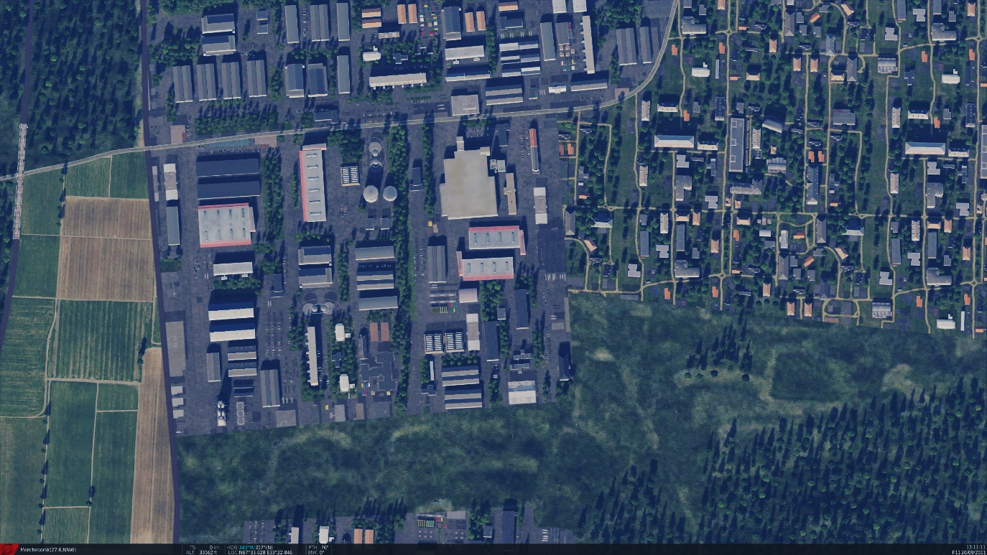
SRNTGT073 - Apatite Radar Factory
WARNING
SRNTGT072 and SRNTGT073 in close proximity!
N
SRNTGT072
SRNTGT073
DESCRIPTION OF THE DESIRED POINTS OF IMPACT
N 67 34.854 E 033 23.303 – 500 ft,SRNTGT073 -A: Production facility
N 67 34.886 E 033 23.302 – 500 ft,SRNTGT073 -B: Storage of finished products
N 67 34.864 E 033 23.373 – 500 ft,SRNTGT073 -C: Power to production facility
N 67 34.823 E 033 23.407 – 500 ft,SRNTGT073 D: Research and Development
N 67 34.814 E 033 23.395 – 500 ft,SRNTGT073 E: Testing building

Slide 3
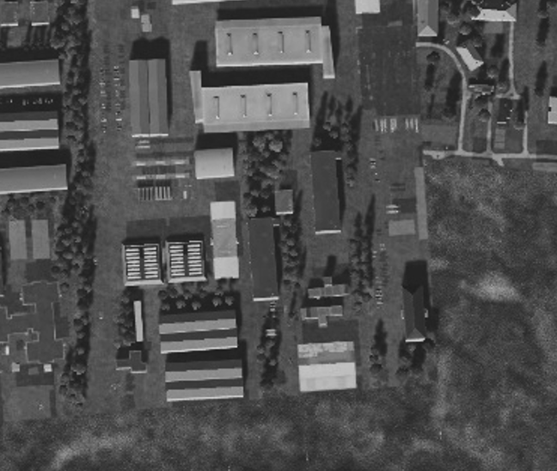
SRNTGT073 - Apatite Radar Factory
Weapon type needed SRNTGT073
SRNTGT073 -A: Production facility – Sensitive electronic components production. The facility can be considered INOP for weeks or more with ONLY this target destroyed.
2x2,000 lbs 25ms, OR 1x2,000 lbs BLU109 60ms
SRNTGT073 -B: Storage of finished products – Immediate supply shortage for air defense units only with this building destroyed – 4x500 lbs OR 1x2,000 lbs needed
SRNTGT073 -C: Power to production facility – Destruction will prolonge facility outage – 1x1,000lbs or 1x2,000 lbs weapon needed, no collateral concern
SRNTGT073 -D: Research and Development – Similar equipment stored as in ‚073A’ therefore mutual destruction is needed for desired effect – at least 1x1,000 or 1x2,000lbs required
SRNTGT073 -E: Testing building
Mutual destruction woth ‚A’ is needed, for same reasons as ‚D’ - at least 1x1,000 or 1x2,000lbs required
SRNTGT073B
SRNTGT073C
N
SRNTGT073D
SRNTGT073A
SRNTGT073E
DESCRIPTION OF THE DESIRED POINTS OF IMPACT
N 67 34.854 E 033 23.303 – 500 ft,SRNTGT073 -A: Production facility
N 67 34.886 E 033 23.302 – 500 ft,SRNTGT073 -B: Storage of finished products
N 67 34.864 E 033 23.373 – 500 ft,SRNTGT073 -C: Power to production facility
N 67 34.823 E 033 23.407 – 500 ft,SRNTGT073 D: Research and Development
N 67 34.814 E 033 23.395 – 500 ft,SRNTGT073 E: Testing building

